Slide 1


Slide 2

CAFÉ BILLING SYSTEM
RED CAFFINO

Slide 3
GROUP MEMBERS
ABDULLAH NAEEM ______________ 043
MUHAMMAD SOBAN_____________046
ABDUL MALIK___________________399

Slide 4
OUTLINES
INTRODUCTION
PROBLEM STATEMENT
ELEMENTS OF PROGRAMMING
OUTPUT SCREEN
CONCLUSION

Slide 5
INTRODUCTION
We proposed a “Cafe Billing System”, it is a program that automate the process of billing .It assists the process of entry of items and calculating the total bill for customer. The program can provide the fast service to the customers and hence improve the performance of our café. Hence maximizing the performance of our café and enable us to provide faster service to our customers.

Slide 6
PROBLEM STATEMENT
In our current situation with existing system, we face different problems like misunderstandings and miscalculations regarding billing.
We also get reviews of our customers regarding our billing system and as every businessman know that “Seriously bad reviews will hurt business”. So, to revoke and overcome these problems we need this system.

Slide 7
Elements of OOP
PROGRAMMING FUNDAMENTAL
CLASSES
OBJECTS
CONSTRUCTOR
INHERITANCE
FUNCTIONS

Slide 8
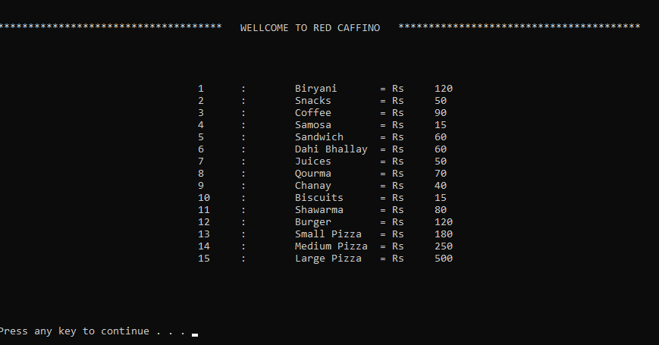
OUTPUT

Slide 9
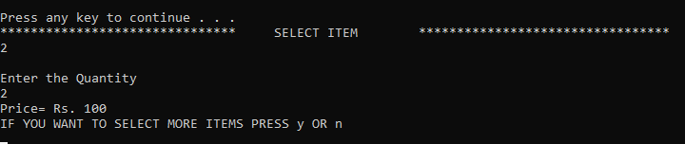

Slide 10
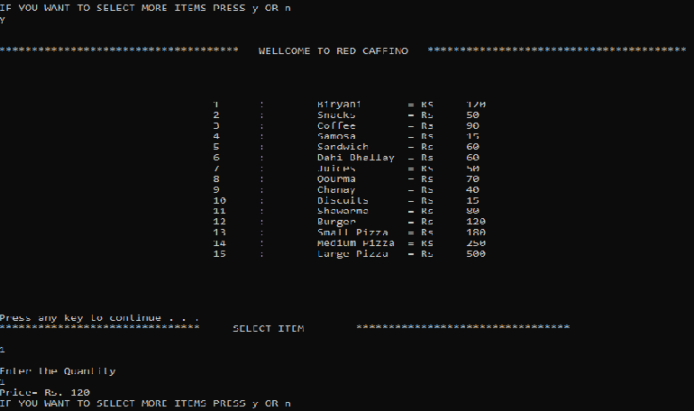

Slide 11
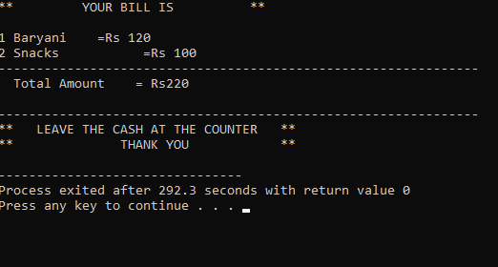

Slide 12
CONCLUSION
This project will help the store keeper in fast billing.
Easy to maintain in future prospect.
This project enables the management team to keep their system updated.
Enable a store, café or shop to deal with their customers in a better way.

Slide 13

Q&A SESSION

Slide 14


